Slide 1
Analysis of student behavior patterns when using large-scale public online learning
Borisenko Anzhelika, Savishchenko Alona, Shalonskaya Ekaterina

Slide 2
Project repository & Project communication channel
https://github.com/katshalonskaya/Project-for-AoSN - Project repository
https://drive.google.com/drive/u/0/folders/1u3kTOzkNZ13J6DPuac8thXk4Rbxx_aua - Google Drive
arsavischenko@edu.hse.ru, evshalonskaya@edu.hse.ru, borisenko.angelika98@gmail.com - Project communication channel

Slide 3



Project members & role
Shalonskaya Ekaterina programmer, data collection
Borisenko Anzhelika copywriter
Savishchenko Alona researcher

Slide 4
Key idea and description of the project
Due to COVID-19 online learning became widespread and actual, but how that influenced the behaviour of the students within the educational process is not yet clear. In the process of learning they may acquire different patterns of studying that is as well defined by their socio-cultural characteristics. Moreover, during the online learning, some students may change their role to ‘teacher’ and vice-versa.
Research Gap: many papers introduced SNA to patterns of e-learning, but they often either focus on emergent roles only with additional variables or use SNA as a complementary method.
Our project, instead, will use SNA as the core method in defining the general behavioural structures of student network and in addressing adapted roles of students

Slide 5
The goal of the project and research steps
Research Goal: to identify patterns of student behavior (when solving mathematical problems using large-scale public online learning Junyi Academy)
typologize students based on their socio-cultural characteristics and behavior patterns
analyze, in accordance with the identified types of students, their models of interaction within the framework of the "teacher-student" model Research Steps: literature analysis → data collection & preparation with descriptive statistics networking → exploratory analysis → interpretation

Slide 6
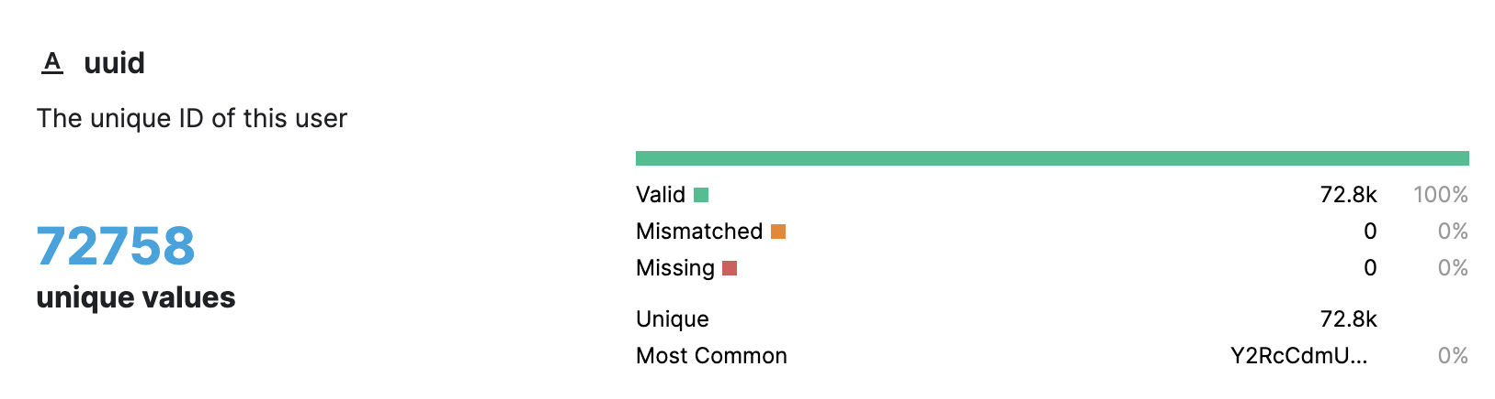
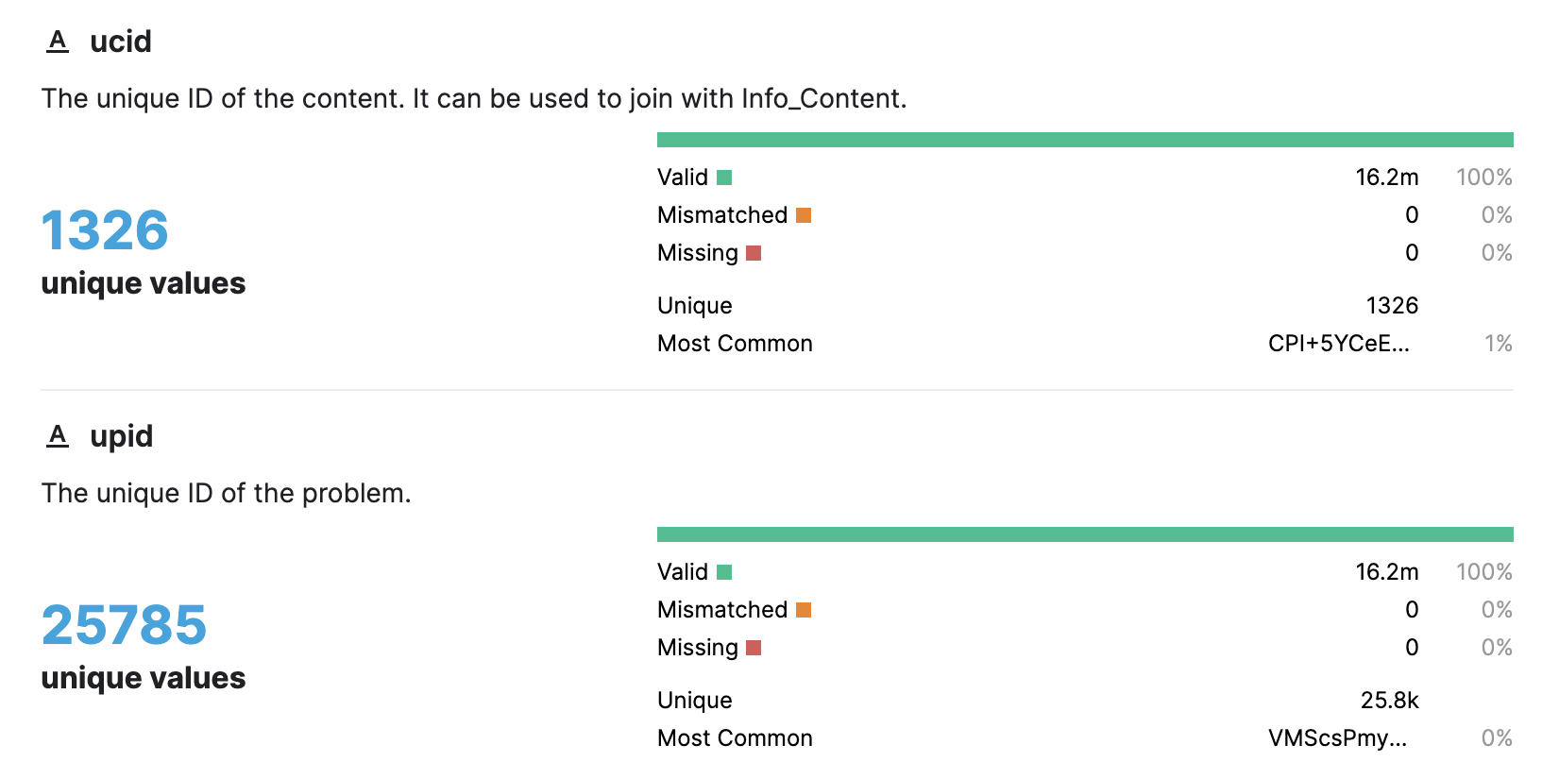
Description of the research dataset

Slide 7
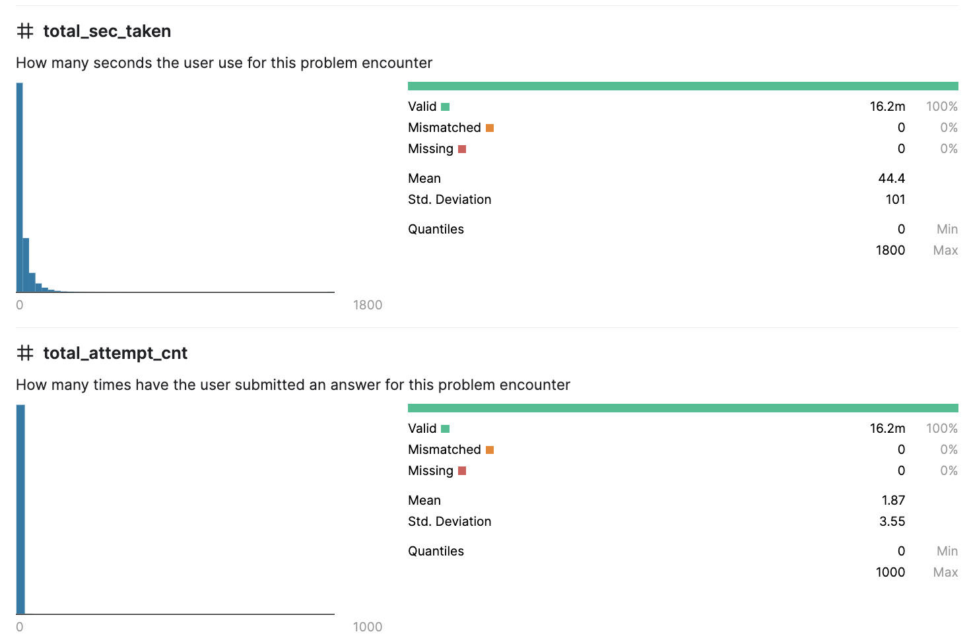
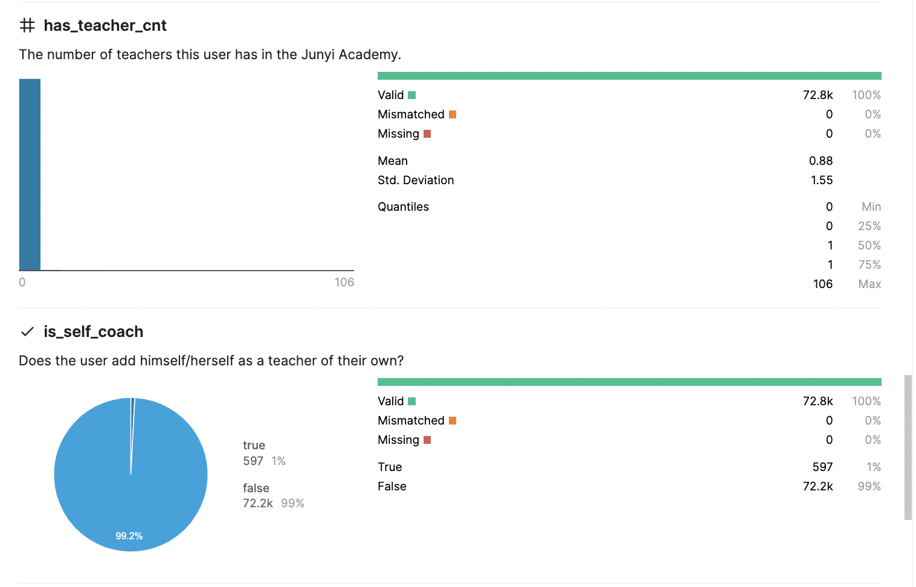
Description of the research dataset

Slide 8
Description of the research dataset
16,217,311 - observations
75728 - students (nodes)
Random sampling of 3638 students (0,05 of all students) and their behavioral patterns (1.284.650)
The data have been cleared and…

Slide 9
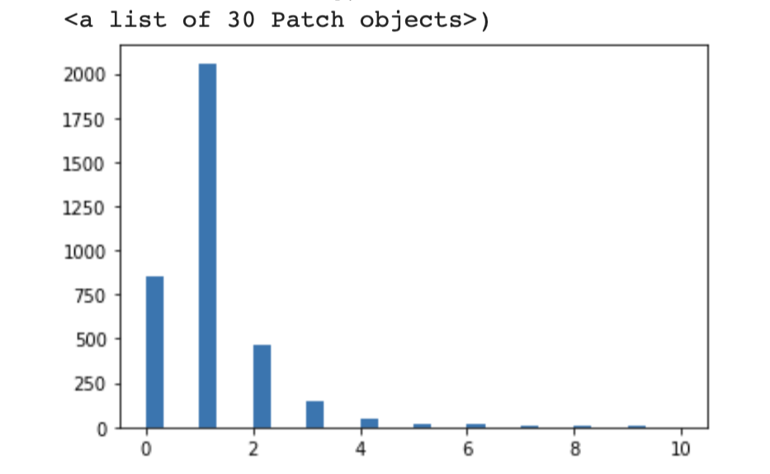
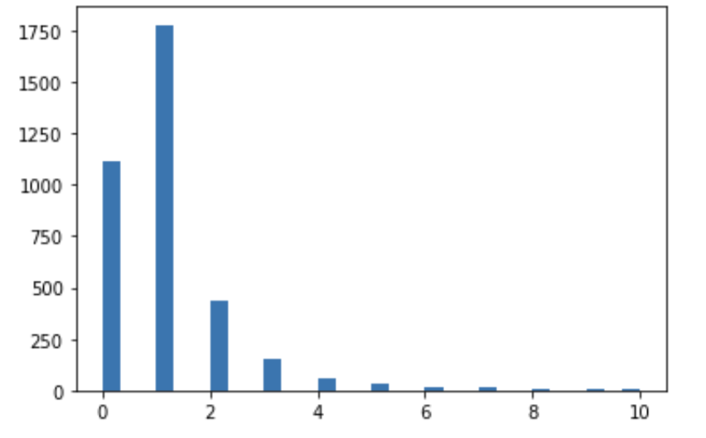
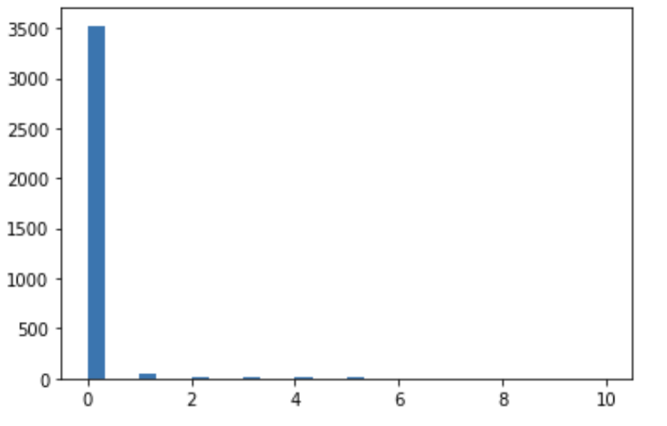
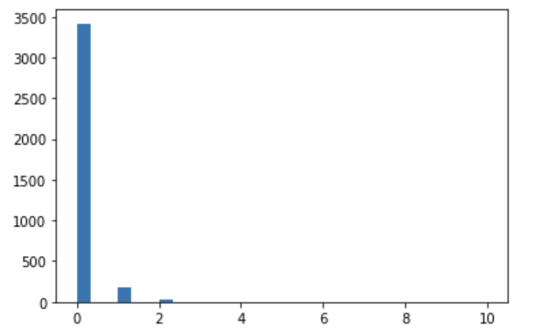
Description of the research dataset

